Slide 1
Introducing CodeX
Mission 2

Slide 2
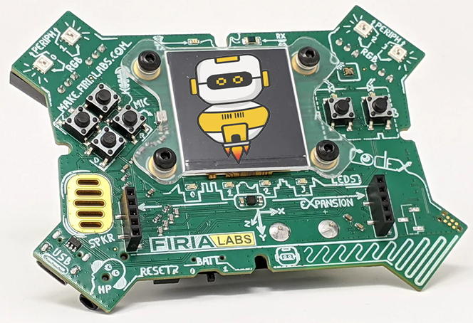
Greetings!
You are at the beginning of an exciting journey, where you will explore coding with your CodeX, using Python.
Why should you learn coding?
It is more than robots
It is more than computers
It is more than laptops or tablets
It is more than cell phones
It is more than games
Computer chips are making lots of things we use smarter. But … everything a computer does is coded by people like YOU

Slide 3

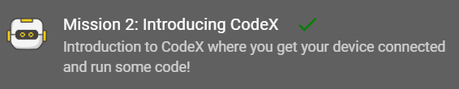
Pre-Mission Preparation
In your Mission 2 log, answer the pre-mission preparation questions:
What are some things you can attach to a computer or laptop?
Why do you think you should learn to program a computer?

Slide 4
What is a CodeX?
A physical device for computing
A circuit board, with a lot of stuff added to it
  Bright, colorful LED lights
  Color graphics display
  Built-in speaker
  Several buttons for input
  Sensors
  And more!

Slide 5
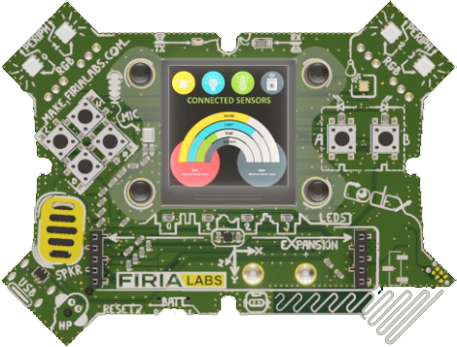
Objective #1: Behold the CodeX
The Firia Labs codeX is a powerful embedded computer
LCD display
LED lights
Speaker
Sensors
Buttons

Slide 6


Mission Activity #1
The instructions have three words that can be added to the toolbox
DO THIS:
Click on one of the words
Fill out the Mission Log for your word
Recommended: click on all three words to add them all to your toolbox

Slide 7

Objective #2: Static electricity
Static electricity ⚡can build up inside you when you walk across a carpet, or many other activities
Static electricity ⚡ can discharge when you touch the CodeX
This is not good for the CodeX!

Slide 8
Objective #2: Static electricity
Follow these guidelines to keep your CodeX static-free
Hold the CodeX by its edges
Be gentle with the components
Keep the CodeX in its case when not in use
Touch grounded metal (doorknob, desk, etc.) before touching the CodeX

Slide 9
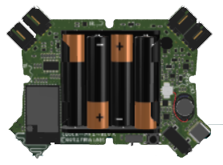
Mission Activity #2
Use the simulator to look for three lightning bolts ⚡on the CodeX.
DO THIS:
Close the instruction panel
Use camera controls to rotate the CodeX in the scene
Find all three ⚡and click on them
One is on the back, so make sure you rotate all the way around

Slide 10

Safety quiz
Do you remember how to keep your CodeX safe?
Answer the quiz question
CODEX
QUIZ

Slide 11
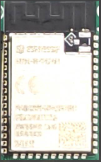
Objective #3: Find the CPU
Where does the code run? On the CPU
Central Processing Unit
The “brain” of the CodeX
Interacts with other computer parts (called peripherals)
  Lights
  Display
  Speaker
  Sensors

Slide 12
Objective #3: Find the CPU
The CPU has many responsibilities:
Collects data
Issues commands
Pushes display information
Stores information
And many more things

Slide 13
Mission Activity #3
The CPU is an amazing device!
DO THIS:
Click on to add it to your toolbox
Write about the CPU in your Mission Log
Close the instruction panel
Use the camera controls to rotate the CodeX and find the CPU
Click on the CPU

Slide 14
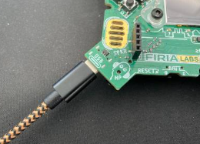
Objective #4: Connect the USB
A USB cable is used to connect the CodeX to your computer or laptop
The USB cable lets your computer communicate with the CodeX.
It provides 5 volt DC power to the CodeX.

Slide 15
Mission Activity #4
DO THIS:
Close the instruction panel
Use the camera controls to rotate the CodeX and find the USB port
Click on the port

Slide 16
Objective #5: Link to CodeSpace
The CodeX must be linked to your browser before it can be used with CodeSpace.

Slide 17
Mission Activity #5
DO THIS:
Gently take out your CodeX
Connect the CodeX to your computer with a USB cable
Close the pop-up window

Slide 18
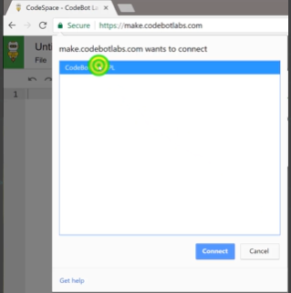

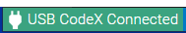
Mission Activity #5
DO THIS:
Click on the red message at the bottom of the window
Select CodeX from the pop-up window
Click the
Notice that the message now says

Slide 19
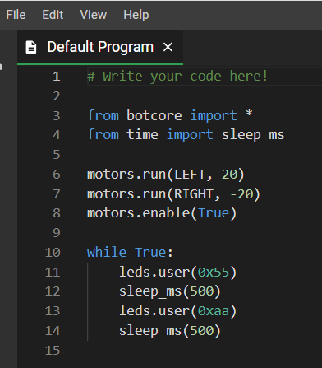
Objective #6: Save the code
Time to create a file!
When you type code into the text editor panel, it is automatically saved in the CodeSpace cloud!
Your code is stored in a file
The file name should describe what the code will do

Slide 20
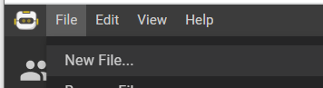
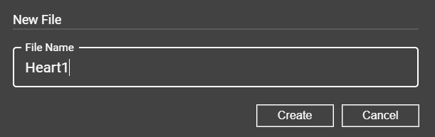
Mission Activity #6
Create a new file for each mission.
DO THIS:
Click the File menu button
Select “New File…”
Name the file Heart1
  no spaces in a file name
Click Create

Slide 21

Objective #7: The CodeTrek
The CodeTrek icon is at the bottom of the instruction panel.
The CodeTrek is a CodeSpace tool that gives you:
A starting point for your program.
Information about lines of code you need to write.
Explanations of coding topics.
Holes (TODOs) for you to fill in on your own!

Slide 22


Objective #7: The CodeTrek
# TODO -- The words “to do” put together
A tells you what you need to do to complete the program
It tells you there is still work TO DO!!
If you haven’t typed in code where there is a .. then you haven’t completed the mission.

Slide 23
Mission Activity #7
Check out CodeTrek
DO THIS:
Click on the CodeTrek icon at the bottom of the instruction panel
Read both messages
Close the CodeTrek

Slide 24
Mission quiz
You have learned a lot more about CodeSpace and CodeX. Now …. time for another quiz!
Answer two quiz questions
CODEX
QUIZ

Slide 25

Objective #8: Show some heart
Important programming notes:
Your code is case sensitive
That means
  lower-case needs to be lower-case
  upper-case needs to be upper-case
Punctuation is important
  Indenting matters
  Use a period . when needed
  Match parenthesis ( )
  Use a colon : where needed

Slide 26
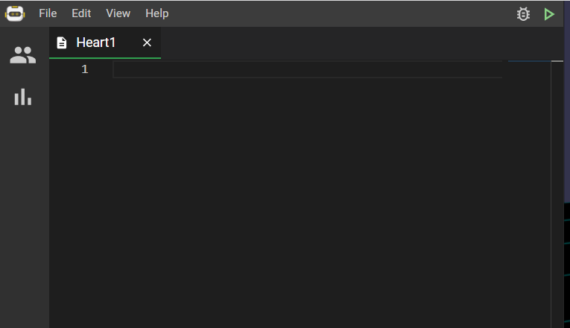
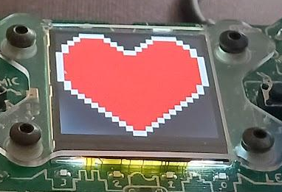
Mission Activity #8
Time to type!
DO THIS:
Make sure your Heart1 file has no code
Click the icon to open CodeTrek
Type the two lines of code EXACTLY as you see it
Run the code
Run the code

Slide 27
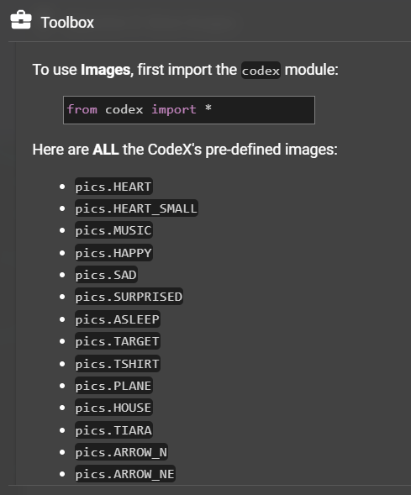

Objective #9: More images
The CodeX comes with more than one image ready for you to display
Find the images that are built-in
Click on
Then scroll down in the toolbox until you find the list of images
Scroll to see the list of images

Slide 28
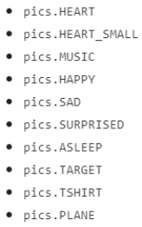
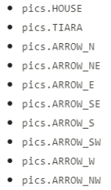
Mission Activity #9
Find out what images you can use
DO THIS:
Go to your Mission Log and write down three images that interest you

Slide 29
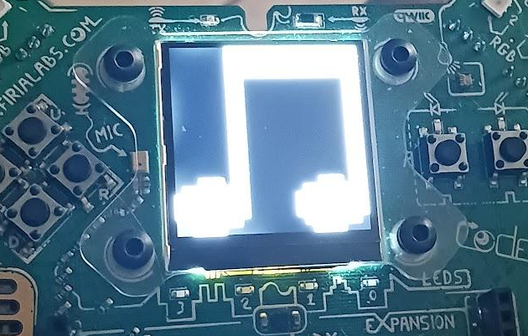
Mission Activity #9
Display a different image
DO THIS:
Go to your Heart1 file
Change the image from HEART to MUSIC
  Use CodeTrek if you need help
Run the code
Change the code to display another image
  Repeat for as many images as you want

Slide 30
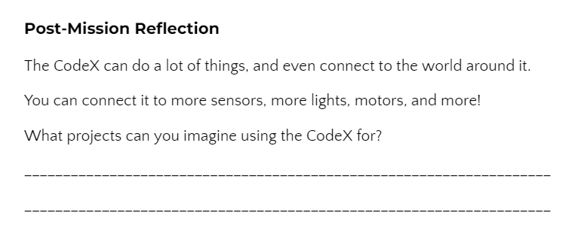
Post-Mission Reflection
Read the “completed mission” message and click to complete the mission
Complete your Mission 2 Log

